Slide 1

Capacity Analysis and Trends (CAT) XL November 2010 Analysis
GSS PSO, Scientific Officer Team
January 2011

Slide 2

Objectives
Predict top CPU% utilization in XL RB servers, based on events load in production
Find maximal load per server, within SLA
Alert on capacity upgrade, based on business prediction
Predict the effect of improvement in events handling
Suggest machines balance

Slide 3
XL RB Data
Data collected per each RB server (total 26), over 30 days (November, 2010)
Num of events (Voice, SMS, GPRS and RPL) per hour
Average CPU% (Usr% and Sys%) per 5 sec
Data is arranged in bins of all events and CPU% data for the hr of the day, per server:
#events - 30 measurements
CPU% - 21,600 measurements
Objective: Per events data in bin, predict Ctop, so that the probability of a CPU% in the bin to be below Ctop is 99.8%

Slide 4
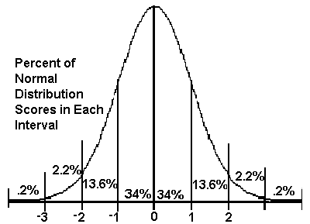
CPU% has Log-Normal Distribution
Log(CPU) distribution
Avg and std of Log(CPU)
Log(CPU%) has a normal distribution in any hr
Example:
Avg( log(CPU))
Stdv( log(CPU))
The probability for CPU in Bin of
log(CPU) < Avg(log(CPU))+3*Std(log(CPU))
is 99.8%
Sasha: Please add the distribution graphs you had for RB1 peak hr

Slide 5
RB1 error function

Slide 7
From log(CPU) to CPU
The probability for CPU in Bin of log(CPU) < Avg(log(CPU))+3*Std(log(CPU)) is 99.8%
The probability for CPU in Bin of CPU < exp { Avg(log(CPU))+3*Std(log(CPU)) } is 99.8%
To find Ctop we need to predict:
Avg (log(CPU)) as a function of #events
Std (log(CPU)) as a function of #events

Slide 8
Thank You Slide or Alternative Title Slide

